Slide 1
Milestone 4 - Group 5
What Makes A Kickstarter Successful?
By: Zack Brown, Rachel Fluegel, Xiaojing Ge, and Jing Sun

Slide 2
Team Member’s Contribution
Zack Brown: Data Summarization & Visualization, Conclusion, and Review
Rachel Fluegel: Data Source & Collection, High-Level, Summarization & Visualization, and Regression Analysis
Xiaojing Ge:Introduction, Data Collection, Data Set Cleaning, Predictive Modeling, and Review
Jing Sun: GitHub Creation, Introduction, Data Set Cleaning, Predictive Modeling, and Review

Slide 3
Background on the Data
What is Kickstarter?
One of the most popular places where can help people to get the funding and bring their concepts to life.
A website called Kickstarter.
Kickstarter is an online fundraising platform.
Projects on Kickstarter comes from different categories. (Art, Dance, Design, Comics, Games, Food, Fashions……)

Slide 4
Data Source and Business Scenario
Data Source: (https://www.kaggle.com/toshimelonhead/400000-kickstarter-projects)
Business Scenario:
How can we build a predictive model to estimate how likely a project will be successful?
What is the percentage of each business group that was successful?
What variables are consistent through the successful/failed business category projects?
How much does each variable affect the end result of each business category?
Who can be benefit from the project?
Why would this analysis be important?

Slide 5
Data Analysis Guideline
Part 1. Data Manipulation and Cleaning
Part 2. Data Summarization and Visualization
Part 3. Regression Analysis
Part 4. Prediction Analysis

Slide 6
Data Manipulation and Cleaning
Step1. We dropped some variables which contain some missing values.
Step2. We converted 'True', 'False' values in dataframe as 1 for True and 0 for False.

Slide 7
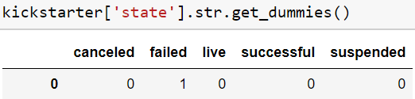
Data Manipulation and Cleaning
Step3. We made the columns with date and time into a datetime.
Step4. We changed categorical variables to dummies.

Slide 8
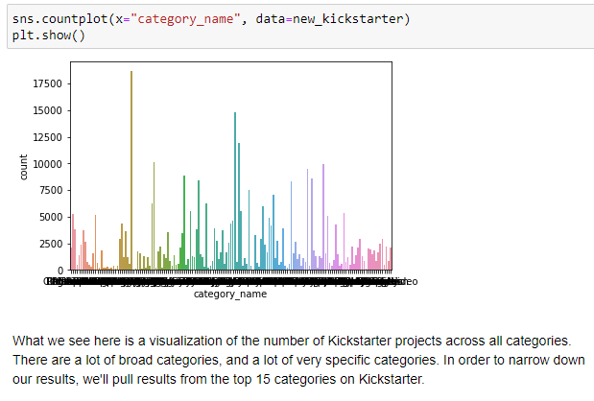
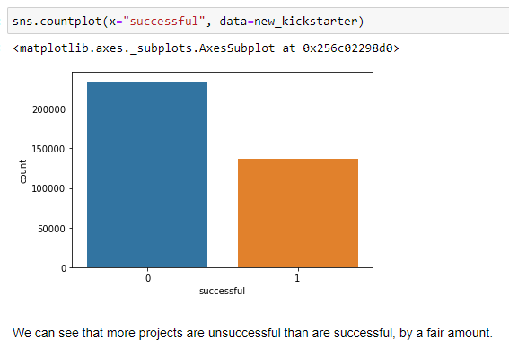
Data Summarize & Visualization

Slide 9
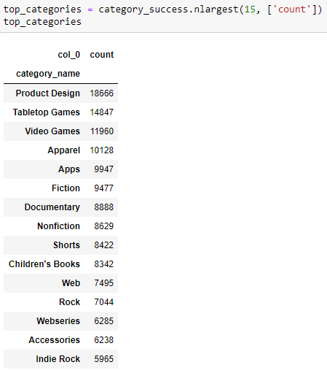
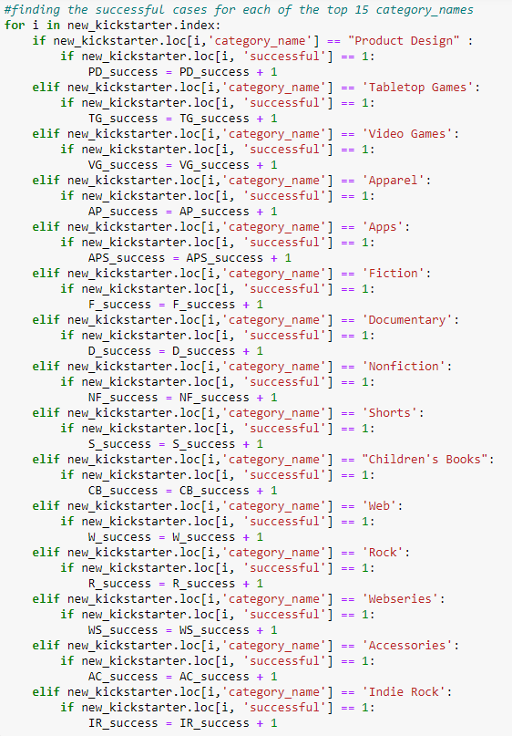
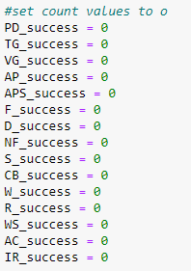
Data Summarize & Visualization - Finding Top 15 Categories

Slide 10
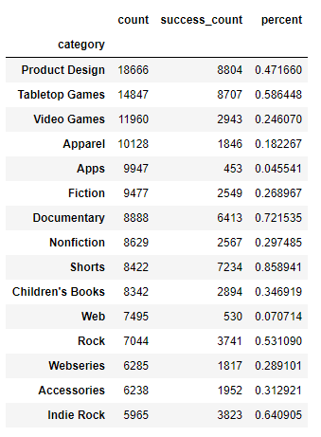
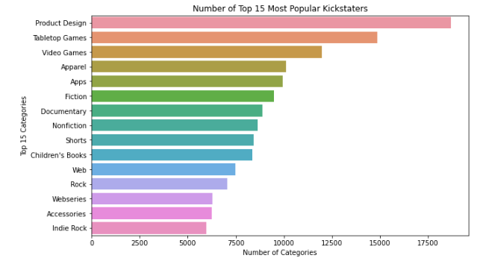
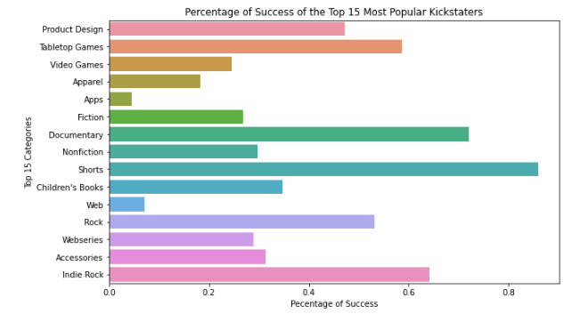
Data Summarize & Visualization - Finding Top 15 Categories
Number of Top 15 Most Popular Kickstarter
Percentage of Success of the Top 15 Most Popular Kickstarter

Slide 11
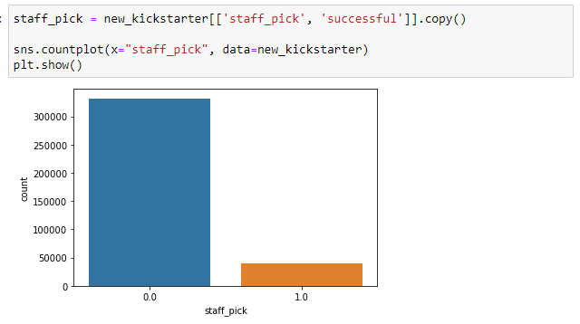

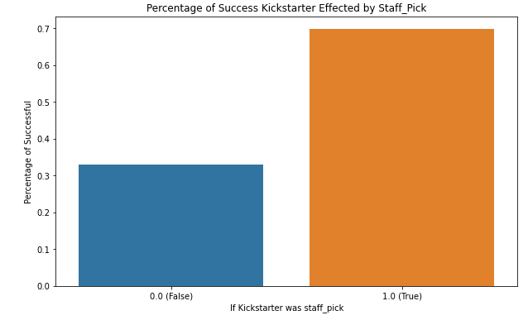
Data Summarize & Visualization - Staff_Pick

Slide 12
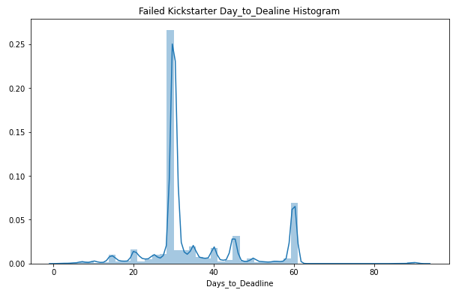
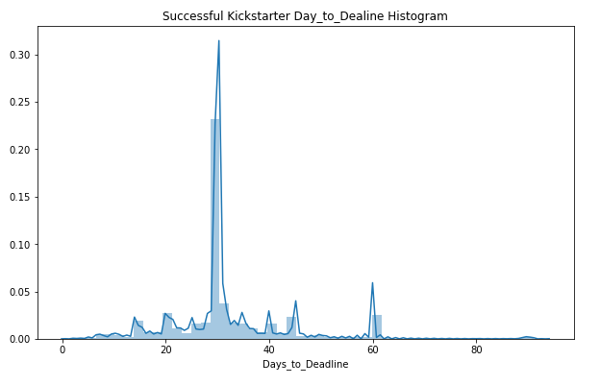
Data Summarize & Visualization - Day_To_Deadline

Slide 13
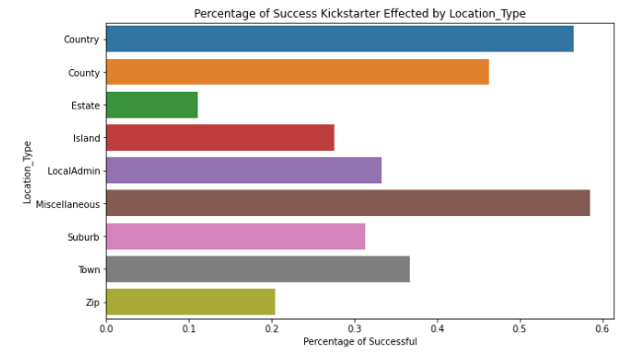
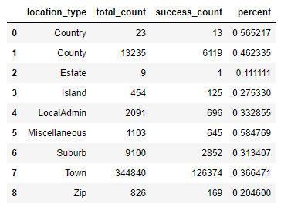
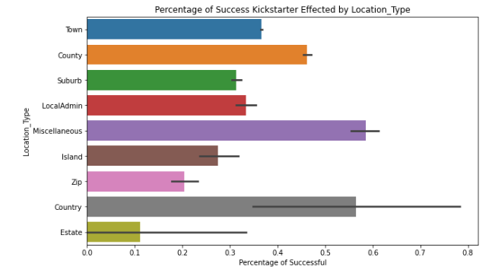
Data Summarize & Visualization - Location_Type

Slide 14
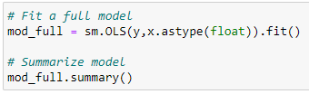
Regression Analysis
Y is new_kickstarter[‘successful’]
X is new_kickstarter[['goal_USD', 'usd_pledged', 'staff_pick', 'year', 'days_to_deadline', 'blurb_length', 'location_type']]
x = pd.get_dummies(x, prefix='', prefix_sep='', columns=['year', 'location_type'])
x = sm.add_constant(x)

Slide 15
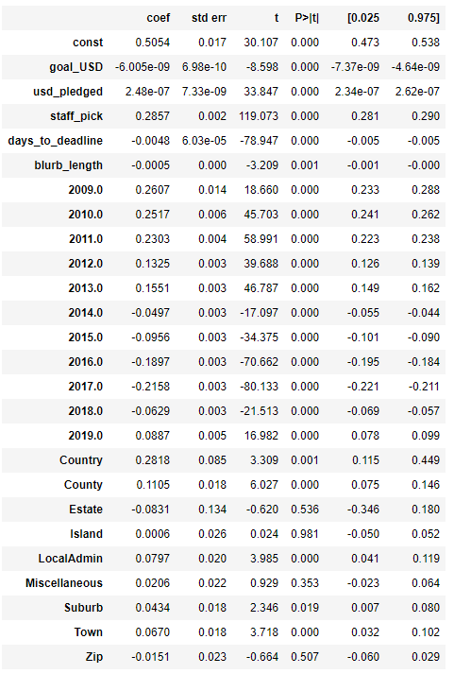
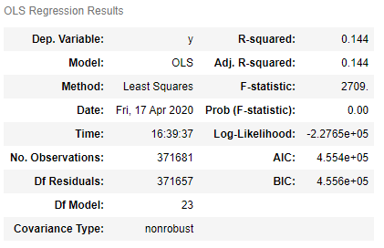
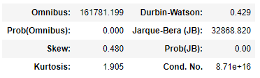
Regression Analysis of the Whole Dataset
Findings
5 are not statistically significant
Staff_pick has a positive effect on the success of a Kickstarter. Increasing the staff_pick by 1 would increase the chance of success but 0.2857.
USD_Pledged has a positive effect on the success of a Kickstarter. Increasing the usd_pledged by 1 would increase the chance of success but 2.448e-07.
For all of the dummy variables for the original variable year, they are all statistically significant but there is a difference between there being a positive or negative effect on success. In earlier years (2009-2013) and 2019, there is a positive effect on success. In the middle years (2014-2018) there was a negative effect on success. We can see that there was more success in the earlier years and last year than all of the other years. This could be due to Kickstarter falling off a bit in 2014 and making a resurgence in 2019.
There are a few different predictors that do not have statistically significant effects on success (p-value > 0.01)

Slide 16
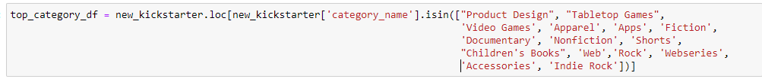
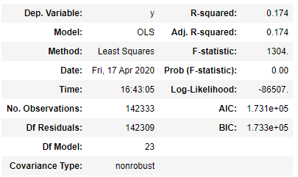
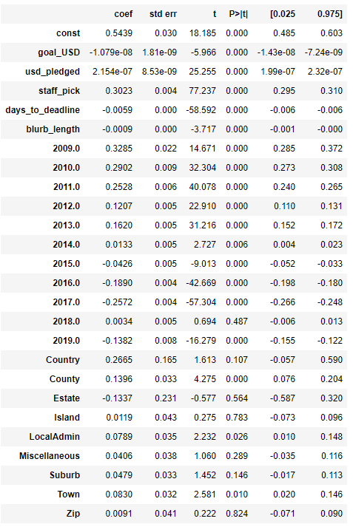
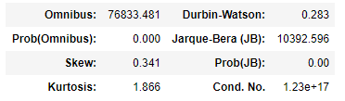
Regression Analysis of the Top 15 Categories
Findings
8 are not statistically significant
Differences
The coefficients for the year dummy variables are showing a different trend in the top 15 categories. There are still positive coefficients in the early years (2009-2013) and the year 2018. The negative coefficients are in the years (2014-2017) and 2019. There is a slight difference in the years between the whole data set and the top 15 categories in the years 2018 and 2019. The year 2018 also now has not statistically significant since the p-value is 0.487 which is greater than 0.01. Even though there is a change in 2018, with the top 15 categories there is no sign of the year to the success of Kickstarters.
There are more predictors that do not statistically significant effects on success (p-value > 0.01) - 2018, Country, Estate, Island, LocalAdmin, Miscellaneous, Suburb, and Zip. There is more location_types that are not statistically significant in the top 15 categories than in the whole data set.

Slide 17
Predictive Analytics
Variables: ['goal_USD', 'usd_pledged', 'staff_pick', 'year', 'days_to_deadline', 'blurb_length', 'location_type']
Models:
1) logistic regression model
2) k-NN classification model
3) Naive Bayes classification model
4) Decision Tree model
5) Random Forests model.

Slide 18
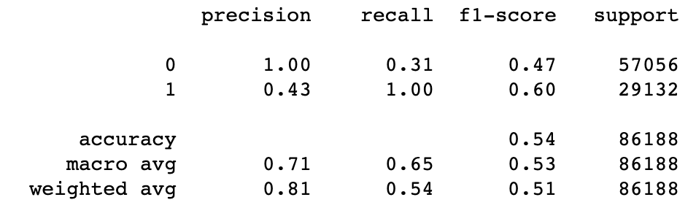
Predictive Analytics Model Comparison
Logistic regression model

Slide 19
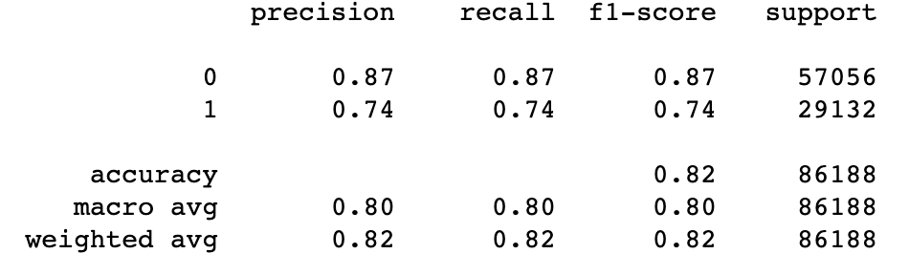
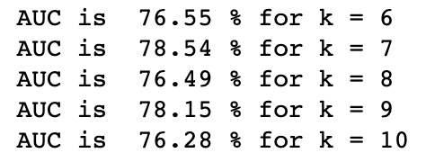
Predictive Analytics Model Comparison
K-NN model for K = 5
K-NN Classifier Tuning based on AUC score

Slide 20
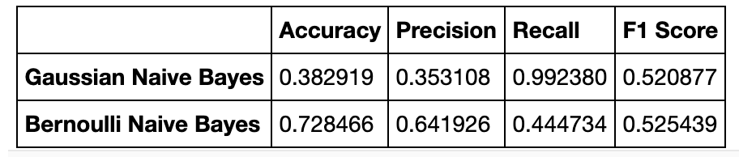
Predictive Analytics Model Comparison
Gaussian and Bernoulli Naive Bayes classification model

Slide 21
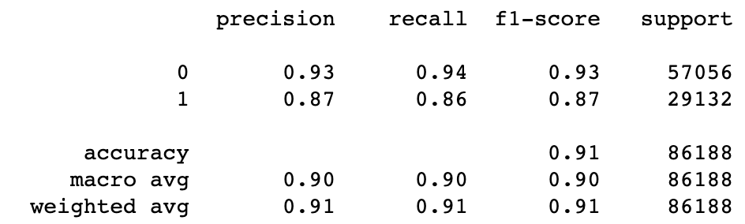
Predictive Analytics Model Comparison
Decision Tree model

Slide 22
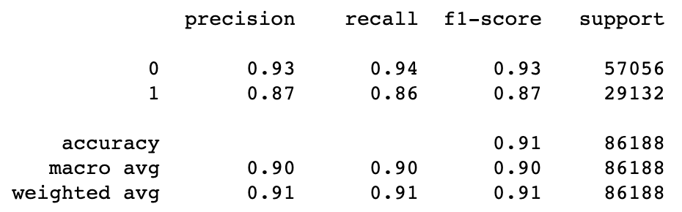
Predictive Analytics Model Comparison
Random Forests Model

Slide 23
Conclusion
What insights you get from the data analysis?
Popularity does not directly correlate to success
Staff picks and projects with plenty of funding seem to do the best
More expensive projects are less likely to succeed
Yearly success is not consistent.
What limitations does the project have?
Looking at broad categories as opposed to specific projects
Can the project be extended?
New criteria could be established to analyze specific projects or types of projects

